Slide 1

Deep Learning based Mutual Fund Returns Forecasting with Sector Based Similarity Measurements

Slide 2

introduction
Mutual fund return forecasting is challenging due to the complex nature of financial markets and the intricate relationships between mutual fund returns and sector performance.
This study proposes a novel deep learning-based approach that leverages sector-based similarity measurements for mutual fund return forecasting.
Similarity measurements are calculated between each mutual fund and its corresponding sector, providing insights into their correlation(cosine similarity) and dependency.
I employ cosine similarity to identify the optimal combinations of mutual funds for investment by selecting those with the lowest cosine similarity. Subsequently, I utilize LSTM (Long Short-Term Memory) to predict the returns for these selected mutual funds.

Slide 3

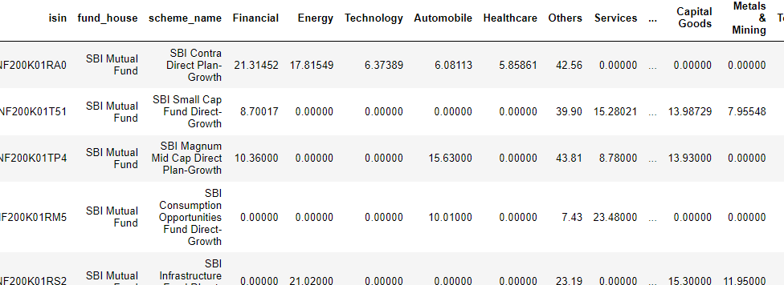
Data Description
Sectors data refers to information about various sectors or industries within the economy, such as technology, healthcare, finance, and energy.
Traders and investors utilize sectors data to analyze the performance and trends of different sectors, identify investment opportunities, and make sector-specific investment decisions

Slide 4

methodology
Calculate the cosine similarity between each pair of mutual fund schemes based on their features or attributes. The cosine similarity measures the similarity between two vectors by calculating the cosine of the angle between them.
From the calculated cosine similarity values, identify the pair of mutual fund schemes with the least similarity.
Gather historical data for the selected pair of mutual fund schemes, including the relevant features and their corresponding returns. Split the data into training and testing sets.
Preprocess the data by normalizing or scaling the features and transforming the returns if required. This step ensures that the data is in a suitable format for training the LSTM model.

Slide 5
methodology
Create an LSTM model with one LSTM layer followed by a dense layer. The LSTM layer helps capture sequential dependencies in the data, while the dense layer allows for non-linear mapping and prediction.
Use the trained LSTM model to predict the returns for the least similar pair of mutual fund schemes in the testing data.
The model takes the features of the mutual funds as input and generates the predicted returns as output.
Evaluate the performance of the LSTM model by comparing the predicted returns with the actual returns of the least similar pair of mutual funds. Use appropriate evaluation metrics such as mean squared error (MSE) to measure the prediction accuracy.

Slide 6
result
Based on the cosine similarity calculations, the combination of mutual funds with the least similarity is the first mutual fund and the second mutual fund.
The LSTM model was trained and used to predict the returns for these two mutual funds.
The mean squared error (MSE) value for the first fund was 37.55, while the MSE value for the second fund was 14.38.
These MSE values indicate the prediction accuracy of the LSTM model for each mutual fund, with lower values suggesting better performance.

Slide 7
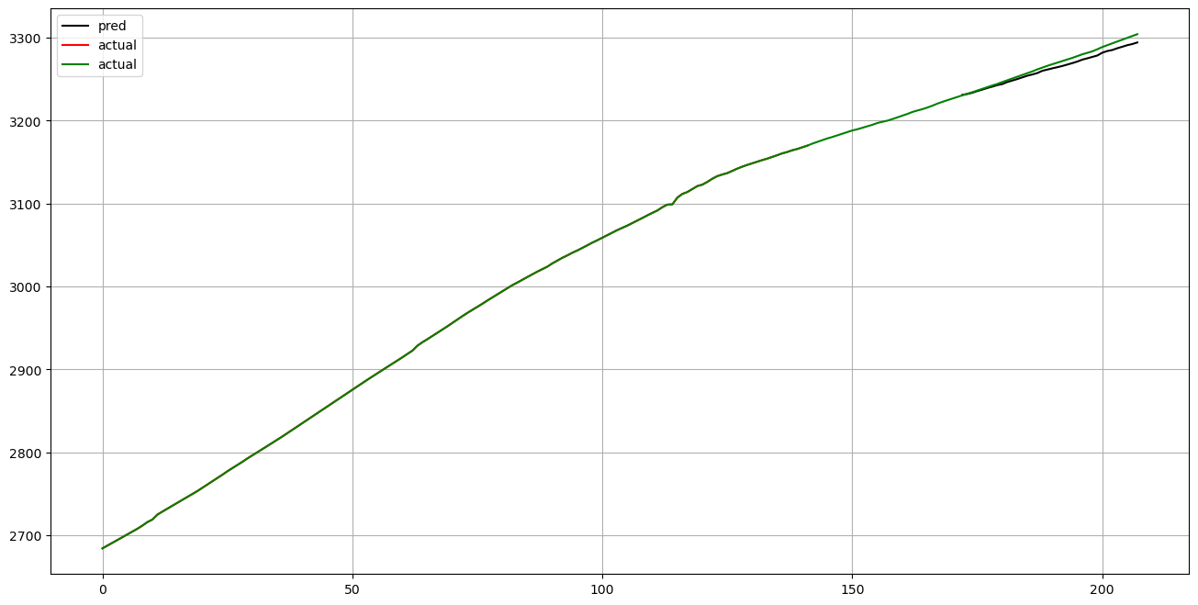

Slide 8

conclusion
In my research, I employ cosine similarity to identify the optimal combinations of mutual funds for investment by selecting those with the lowest cosine similarity.
Subsequently, I utilize LSTM (Long Short-Term Memory) to predict the returns for these selected mutual funds.
By leveraging LSTM, I aim to generate accurate forecasts of future returns based on historical data patterns, facilitating informed investment decisions.

Slide 9
reference
https://www.paytmmoney.com
N. Jing, Z. Wu, H. Wang, A hybrid model integrating deep learning with investor sentiment analysis for stock price prediction, Expert Syst. Appl. 178 (2021) 115019.
https://www.sciencedirect.com/science/article/abs/pii/S0378426609002660
https://www.sciencedirect.com/science/article/abs/pii/S1057521923001278
https://www.sciencedirect.com/science/article/abs/pii/S0927538X21000974

Slide 10
THANK YOU

